Slide 1
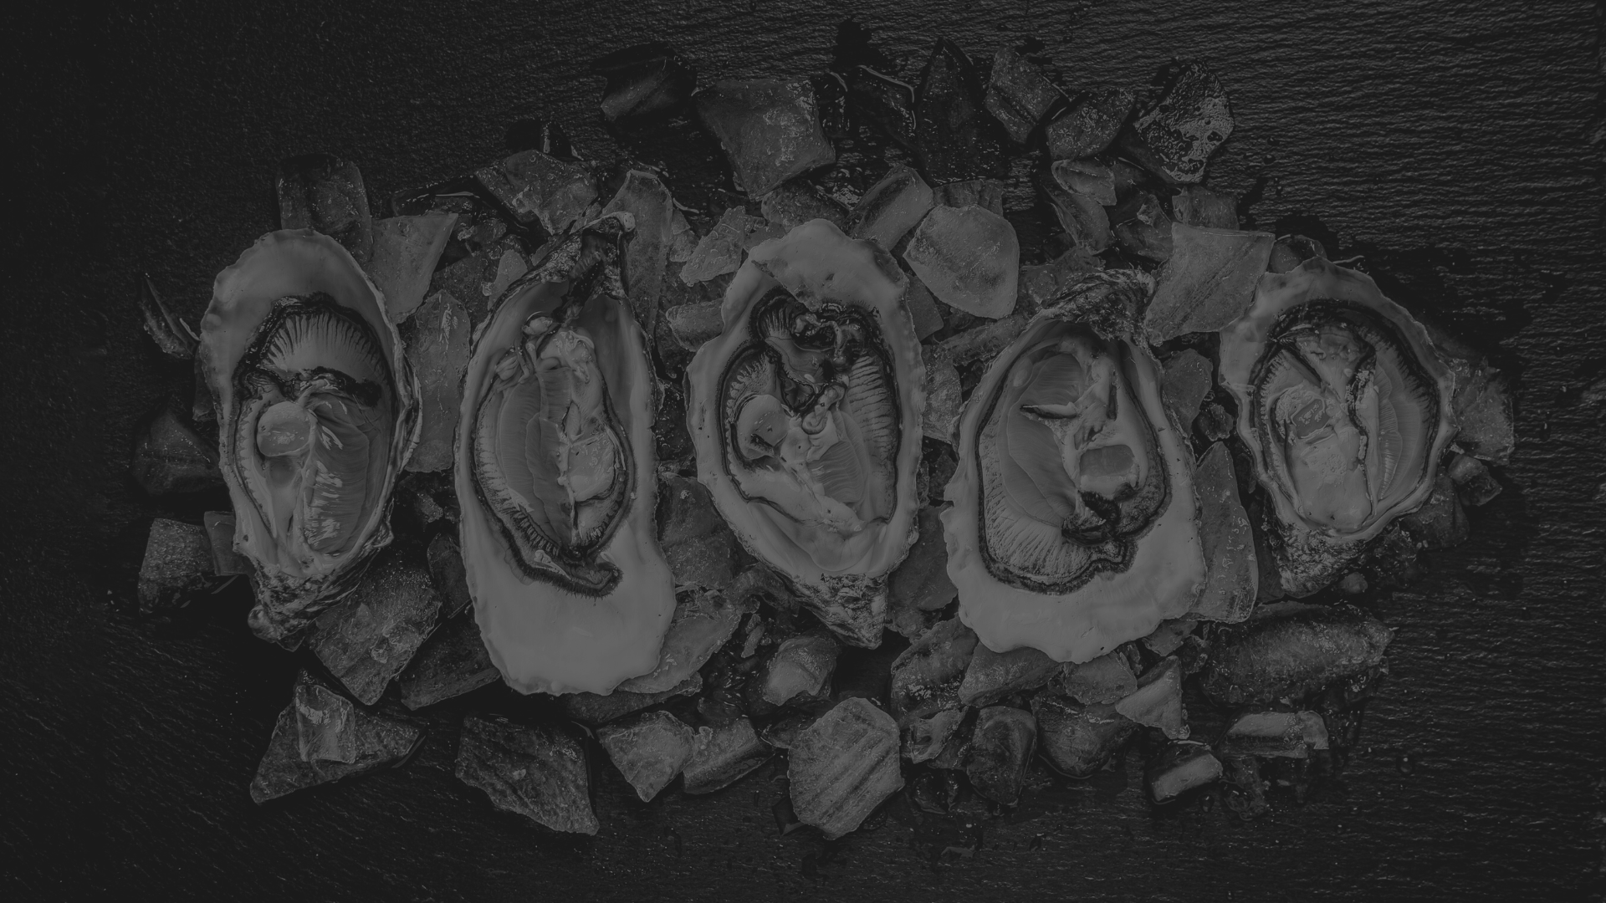
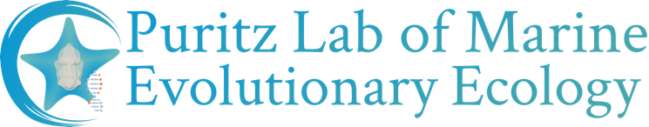

Oyster genomics for everyone:
applications to conservation, management, and aquaculture
University of Rhode Island
Department of Biological Sciences

Slide 2
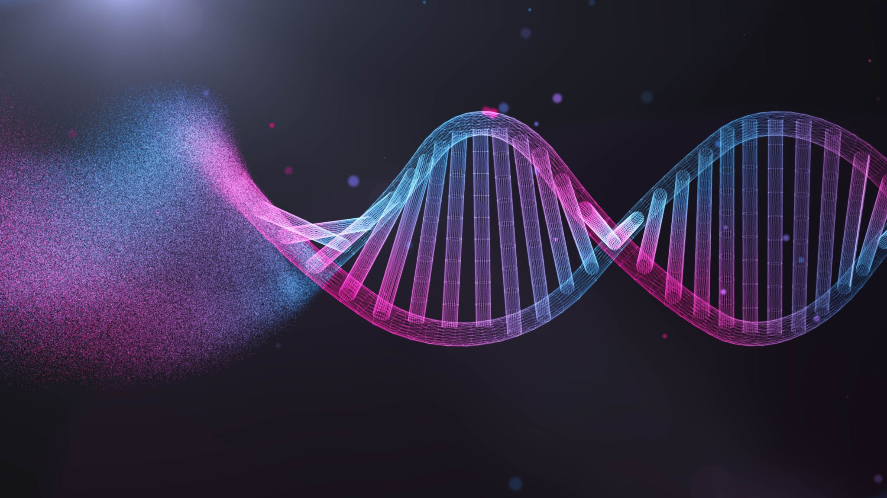
From DNA to SNPs
And what is a SNP anyway?

Slide 3

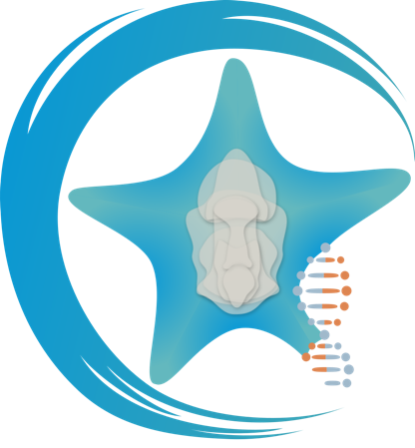

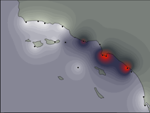
Puritz Lab of Marine Evolutionary Ecology
Developing genomic tools to ask evolutionary questions
Understanding how the environment and humans impact the evolution of marine populations
NGS
Bioinformatics
Connectivity
Selection
Seascape Genomics
Terminal
$ bash
$ python

Slide 4

NGS Output

Slide 5
“Advice is a form of nostalgia. Dispensing it is a way of fishing the past from the disposal, and wiping it off, painting over the ugly parts, and recycling it for more than it’s worth.”
-Baz Luhrmann

Slide 6
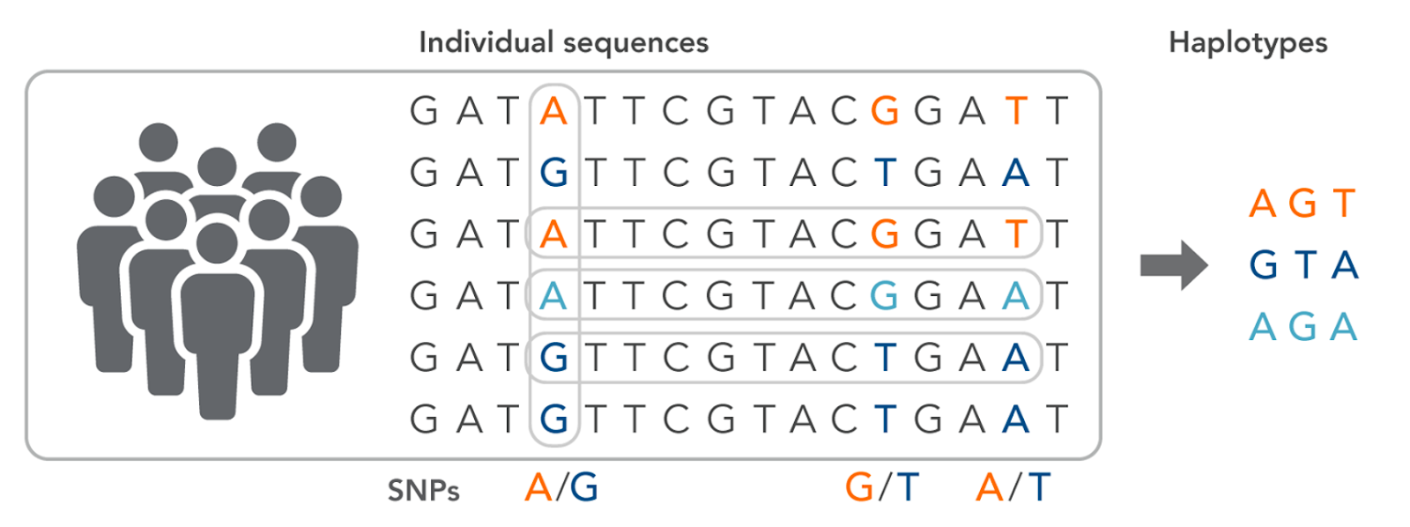
Single Nucleotide Polymorphism (SNP)
Figure from (Ahmed et a. 2021)

Slide 7
Single Nucleotide Polymorphism (SNP)
AATTCACCTCGGGTATCTTCAGGAAAACGGTCAAAATCAGGTTTCACAGTATATTGGACTCCTC
AATTCACCTCGGGTATCTTCAGGAAAACGGTCAAAATCAGGTTTCACAGTATATTGGACTCCTC
AATTCACCTCGGGTATCTTCAGGAAAACGGTCAAAATCAGGTTTCACAGTATATTGGACTCCTC
AATTCACCTCGGGTATCTTCAGGAAAACGGTCAAAATCAGGTTTCACAGTATATTGGACTCCTC
AATTCACCTCGGGTATCTTCAGGAAAACGGTCAAAATCAGGTTTCACAGTATATTGGACTCCTC
AATTCACCTCGGGTATCTTCAGGAAAACAGTCAAAATCAGGTTTCACAGTATATTGGACTCCTC
AATTCACCTCGGGTATCTTCAGGAAAACAGTCAAAATCAGGTTTCACAGTATATTGGACTCCTC
AATTCACCTCGGGTATCTTCAGGAAAACAGTCAAAATCAGGTTTCACAGTATATTGGACTCCTC
AATTCACCTCGGGTATCTTCAGGAAAACAGTCAAAATCAGGTTTCACAGTATATTGGACTCCTC
AATTCACCTCGGGTATCTTCAGGAAAACAGTCAAAATCAGGTTTCACAGTATATTGGACTCCTC

Slide 8
What can SNPs do?
Genome-wide associations
Genomic Selection
Population Genetics
Estimate Pedigree
Genetically informed restoration
How genetically diverse are stocks, lines, individuals?
How closely related are stocks, lines, populations?

Slide 9
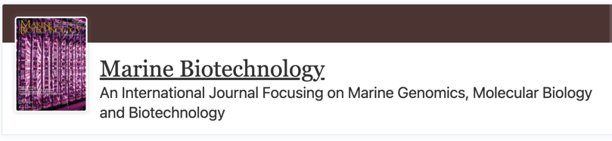
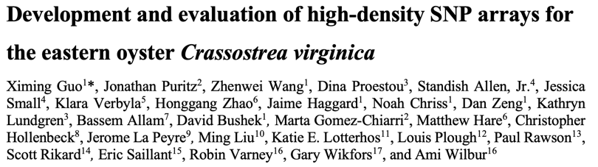
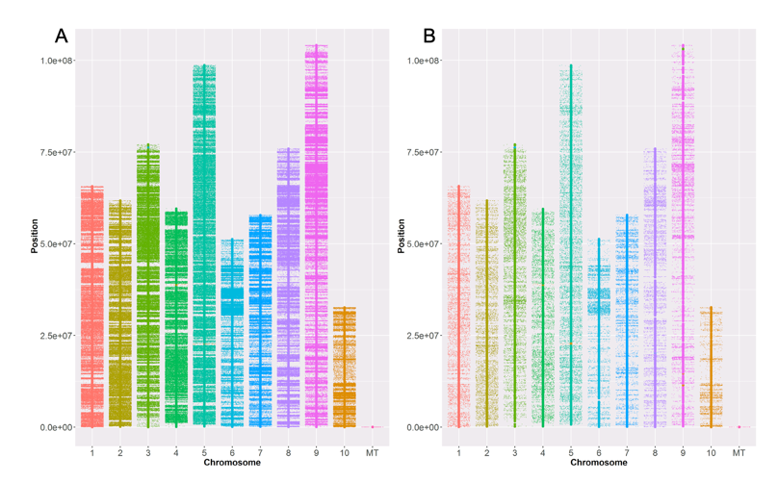
Eastern Oyster Breeding SNP Array
Sequenced 269 individuals to ~15X coverage
Initial filtering produced 10,628,193 biallelic SNPs
Final filtering- 3,661,861 biallelic SNPs
Included:
Known outlier loci ~43,000
Mitochondrial SNPs ~ 33
399 non-polymorphic loci
13 oyster pathogens
Only 2,691,166 SNPs were recommended for the array
Marker composition | 566K ~$50 per sample | 66K ~$25 per sample
Oyster SNPs | 566,262 | 65,893
Nuclear | 566,229 | 65,862
Genic | 47,426 | 22,984
Genomic | 518,803 | 42,878
Mitochondrial | 33 | 31
Pathogen markers | 756 | 756
Total markers | 567,018 | 66,649

Slide 10
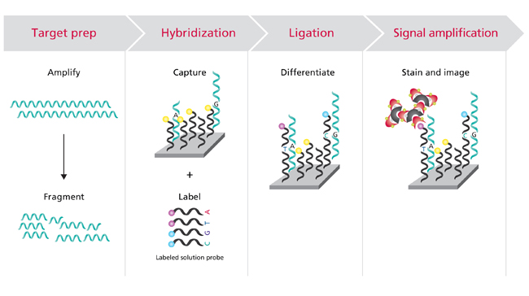
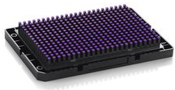
SNP Array
Axiom SNP array by Thermo Fisher
Sample preparation:
1) Ethanol fixed tissue: fix well, 1:5 sample:ethanol ratio
2) Hemolymph: pellet and completely remove serum before fixing
3) Biopsy: dry oysters overnight, Epson salt in 50% seawater, 0.5 - 2 hrs
Adopted from Ximing Guo

Slide 11
SNP Array can also detect pathogens
Bonamia exitiosa
Bonamia ostreae
Bonamia perspora
Haplosporidium costale
Haplosporidium littoralis
Haplosporidium nelsoni
Adopted from Ximing Guo

Slide 12
SNP Array can also detect pathogens
Perkinsus marinus
Ostreid herpesvirus
Aliiroseovarius crassostreae
Vibrio coralliilyticus
Vibrio parahaemolyticus
Vibrio tubiashi
Adopted from Ximing Guo

Slide 13
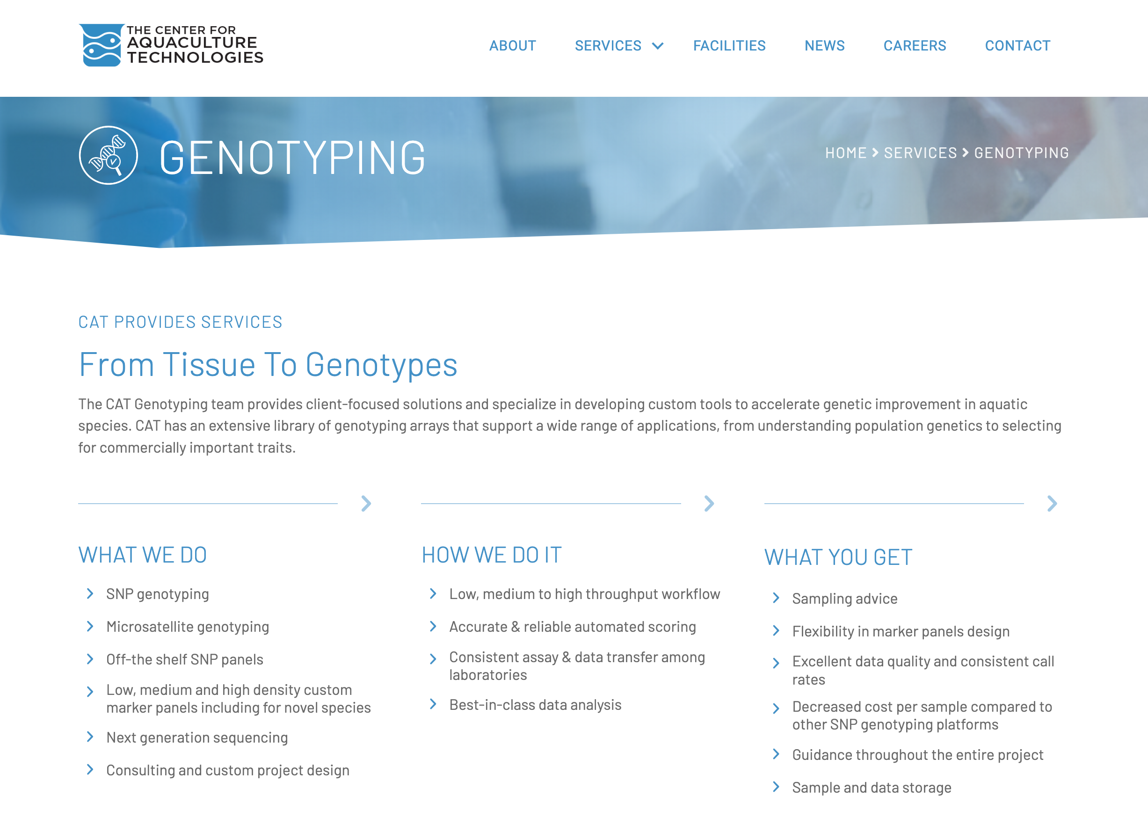
Tissue to genotypes using a provider

Slide 14
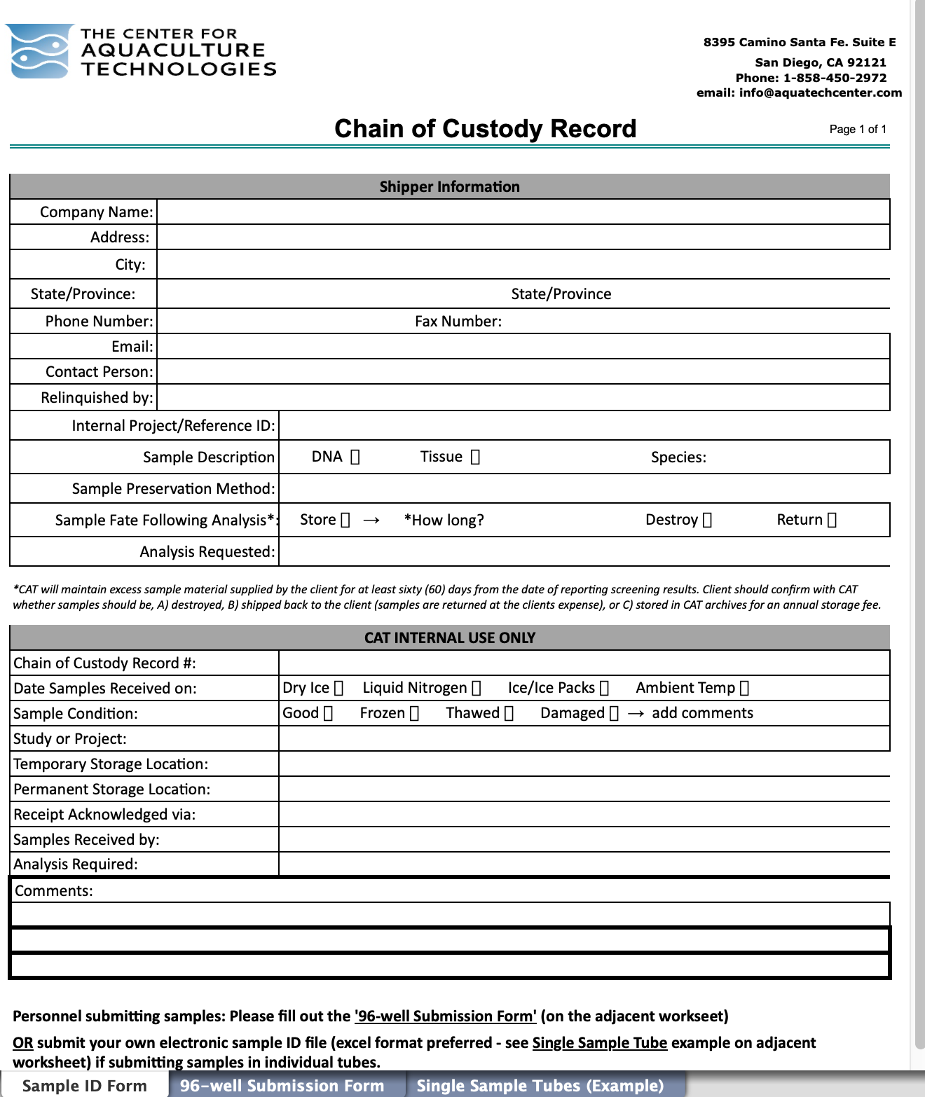
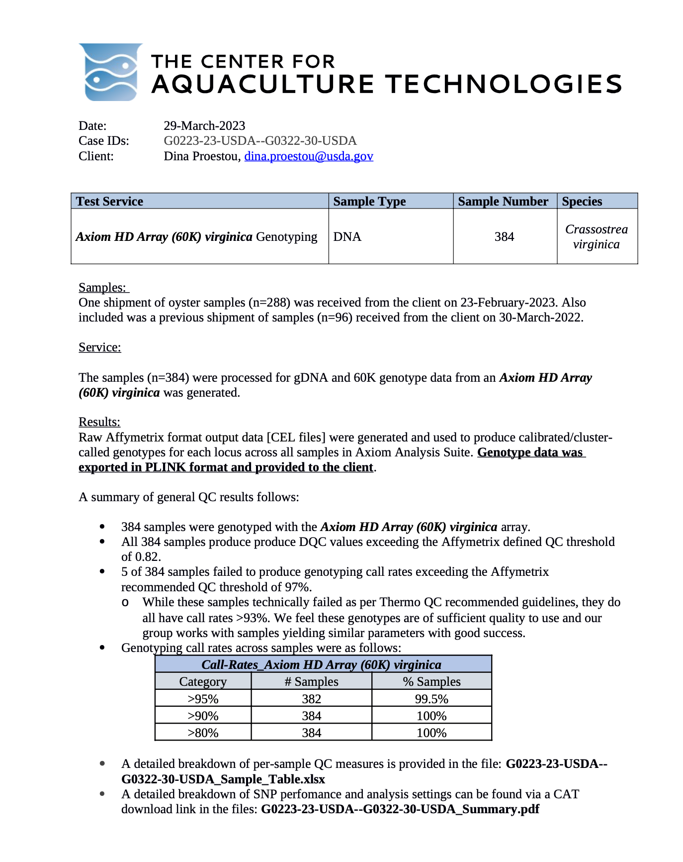
Tissue to genotypes using a provider

Slide 15
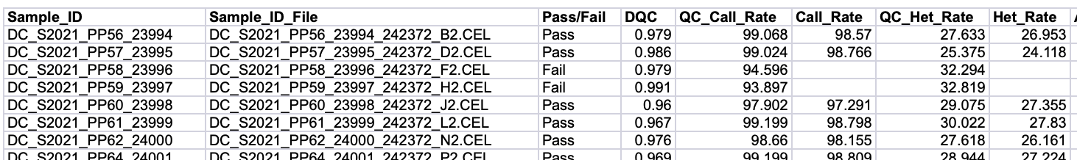
Tissue to genotypes using a provider

Slide 16
SNP Data File Format: PLINK
CAT will provide you with two files: .ped, .map; .bed, .fam, .bim
.ped: binary genotype, no header, each line is a sample, 6+2N fields
First field/column: sample filename
Each additional field/column is allele type
.map: text marker file with no headers, 4 columns
1. Chromosome
2. Marker ID
3. Genetic distance in cM
4. Physical location in bp
Adopted from Ximing Guo

